Slide 1

Data Independence (logical and physical)
and Its Significance in DBMS Architecture
CSA0508-Datsbase Management System
Guided by:
Presented by:
Dr. Ayyappan G
Bhuvaneswari S (192571048)
Btech Computer science and Bioscience

Slide 2
Presentation Outline
Introduction
What is DBMS?
DBMS Architecture Data Abstraction
What is Data Independence?
Types of Data Independence
Physical Data Independence
Logical Data Independence
Comparison
Advantages
Applications
Challenges
Case Study
Conclusion

Slide 3
Introduction
What is Data Independence?
Data Independence is the ability to modify the database schema without affecting application programs.
It separates data storage from application logic.
It is one of the major goals of DBMS.
Helps databases remain flexible and maintainable.
Keywords
Flexibility
Scalability
Maintainability

Slide 4
What is DBMS?
Database Management System
A DBMS is software that stores, organizes, manages, and retrieves data efficiently.
Functions
Data Storage
Data Retrieval
Data Security
Backup and Recovery
Concurrency Control
Examples:
MySQL ,Oracle ,SQL Server ,PostgreSQL

Slide 5
DBMS Architecture
Definition: Three-Schema Architecture is a DBMS architecture that organizes a database into External, Conceptual, and Internal levels to provide abstraction and support data independence.
External Level
User-specific view of the database.
Conceptual Level
Overall logical structure of the database.
Internal Level
Physical storage and organization of data.
Purpose
Separates user view from physical storage.
Supports logical and physical data independence.

Slide 6
Three-Level Architecture Diagram
Users
│
▼
External Schema
(View Level)
│
▼
Conceptual Schema
(Logical Level)
│
▼
Internal Schema
(Physical Level)
│
▼
Physical Database

Slide 7
Data Abstraction
Definition: Data Abstraction is the process of hiding unnecessary implementation details while showing only the essential information to users.
Levels of Data Abstraction
Physical Level: Describes how data is stored in the database.
Logical Level: Describes what data is stored and the relationships among the data.
View Level: Shows only the required data to specific users.
Purpose
Hides complexity from users.
Improves security by restricting access.
Simplifies database management.
Supports data independence.

Slide 8
What is Data Independence?
Definition:
Data Independence is the ability to change one level of the database without affecting the next higher level.
There are two types:
Physical Data Independence
Logical Data Independence

Slide 9
Need for Data Independence
Easy database maintenance
Faster upgrades
Reduced application modification
Better scalability
Lower development cost
Increased flexibility

Slide 10
Physical Data Independence
Definition:
Ability to change the physical storage without changing the logical schema.
Changes may include:
Indexes
Storage devices
File organization
Compression methods
Applications remain unaffected.

Slide 11
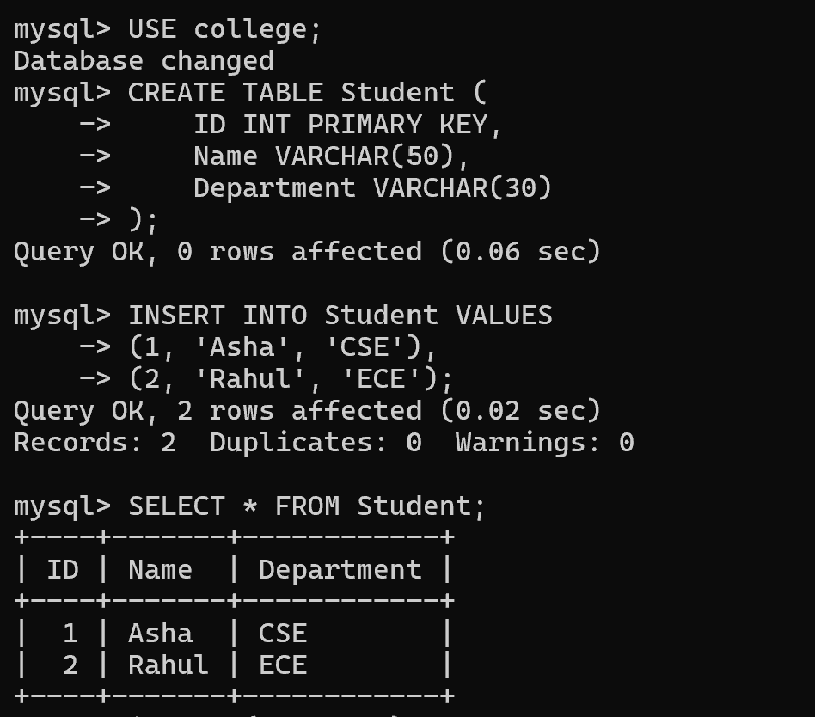
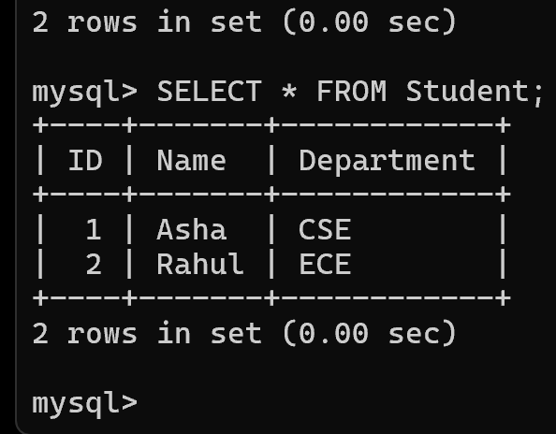
Example of Physical Data Independence
Initially
Student Table
Stored in HDD
Later
Student Table
Stored in SSD
Applications continue working normally because only storage changed.

Slide 12
Logical Data Independence
Definition:
Ability to change the logical schema without affecting external views or application programs.
Examples:
Add new column
Add new table
Modify relationships

Slide 13
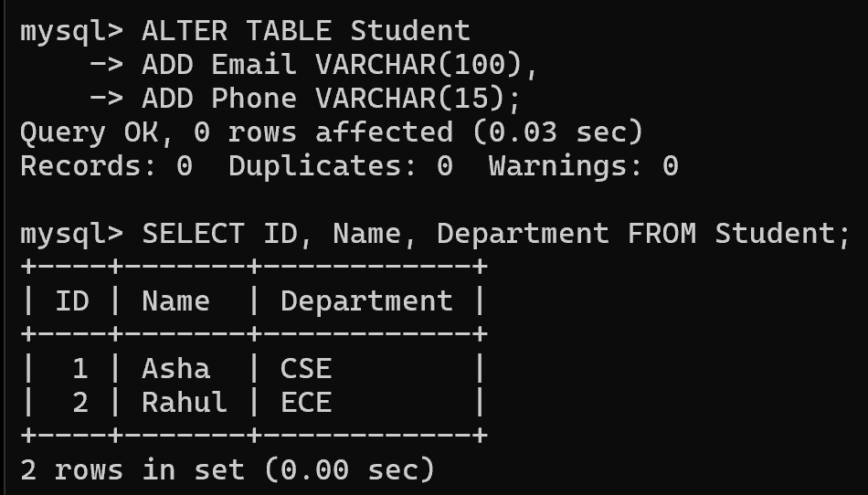
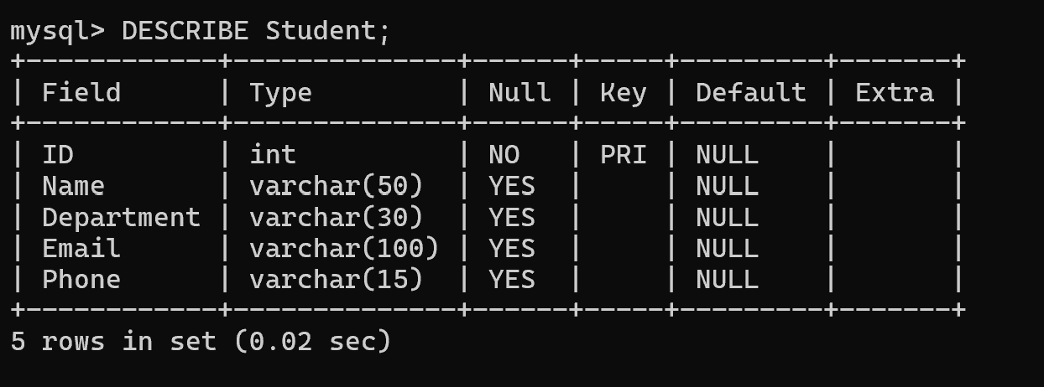
Example of Logical Data Independence
Before
Student
ID
Name
Department
After
Student
ID
Name
Department
Email
Phone
Existing applications continue functioning with little or no modification.

Slide 14
Comparison
Physical | Logical
Internal Level | Conceptual Level
Easier | More Difficult
Storage changes | Schema changes
Better performance | Better flexibility
File organization | Table structure

Slide 15
Real-Life Applications
Banking
Storage upgraded without affecting ATM software.
Hospital
New patient fields added without changing existing applications.
E-Commerce
Database optimized for millions of products.
University
New courses added without affecting student portal.

Slide 16
Conclusion
Data Independence separates applications from database changes.
Two types:
Physical
Logical
Essential feature of DBMS architecture.
Improves flexibility, maintenance, scalability, and performance.

Slide 17


